Slide 1
Title: Tumor specific quantitative analysis (using multiplex immunohistochemistry) reveals independently poor prognostic impact of BCL2 expression in DLBCL
2018.09.14
Notes:
제목: better than IPI 쪽으로.. (staging, prognosis)

Slide 2
Key points
1) Tumor specific quantitative analysis
2) BCL2 expression is independently associated with poor prognosis
Notes:
IPI + COO, IPI + MYC

Slide 3
Abstract
Background: The BCL2 overexpression has been reported to be associated with poor prognosis in diffuse large B-cell lymphoma (DLBCL). However, the criteria for BCL2 positivity by immunohistochemistry are highly variable between studies and only include the semiquantitative evaluation of the proportion of BCL2 expression. In this study, we used automated quantitative analysis (AQUA) score which incorporates both intensity and proportion of immunofluorescence staining.
Patients and methods: We analyzed 211 patients with primary DLBCL who were treated with R-CHOP (rituximab, cyclophosphamide, doxorubicin, vincristine, and prednisone). Tumor-targeted AQUA scorings for BCL2 and MYC expression using multiplex immunofluorescence were performed. The prognostic significance of BCL2 and MYC expression was analyzed using the multivariable fractional polynomial (MFP) algorithm with continuous prognostic index and the traditional multivariate analysis with optimal cutpoints.
Results: A survival analysis revealed that high BCL2 score (N = 83, 39.3%) is significantly associated with poor prognosis independent of age, extranodal involvement, serum lactate dehydrogenase level, Ann Arbor stage, bone marrow involvement, performance status, cell of origin, and the MYC expression. The poor prognostic impact of the BCL2 expression was confirm in an external validation set (N = 111). The BCL2 expression, along with the age and performance status, was also selected by the MFP algorithm at the 5% level in a multivariable model.
Conclusion: We showed the independent poor prognostic impact of the BCL2 expression using reproducible and quantitative scoring system. Implementation of AQUA scoring system and MFP algorithm could be used to categorize patients with DLBCL who might have poor prognosis and be the target of new treatment.
Key words: Diffuse large B-cell lymphoma, BCL2, MYC, Multiplex immunofluorescence, AQUA score, fractional polynomials, prognosis

Slide 4
Result
1) Clinicopathological characteristics
- Variable intentisy of BCL2 expression
2) High BCL2 expression group categorized using conventional method (proportional cutpoint 50%) shows poor prognosis (OS, 2yr EFS). However, these subgroups also show variable BCL2 intensity.
To incorporate the staining intensity into the analysis for BCL2 expression, AQUA score was calculated. As previous analysis, conventional BCL2 subgroups show variable AQUA score.
3) Prognostic impact of BCL2 AQUA score – KM curve (OS, EFS, subgroup), MYC
4) Prognostic impact of BCL2 AQUA score is independent of other clinicopathologic factors
- cox, MFP
5) Prognostic model using BCL2 – MFP PI group
Notes:
IPI + COO, IPI + MYC

Slide 5
Result
1) Clinicopathological characteristics
- Variable intentisy of BCL2 expression

Slide 6
Characteristics |  | N (total = 211) | %
Age > 60y |  | 95 | 45.0
Sex, male |  | 118 | 55.9
LDH > normal |  | 99 | 46.9
B symptoms |  | 55 | 26.1
Stage 3-4 |  | 125 | 59.2
IPI 3-5 |  | 81 | 38.4
non-GCB type |  | 135 | 64.0
Notes:
Table 1. Baseline characteristics of patients with DLBCL
추가로 validation group characteristic → supplement table

Slide 7
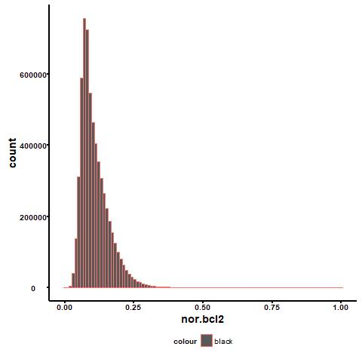
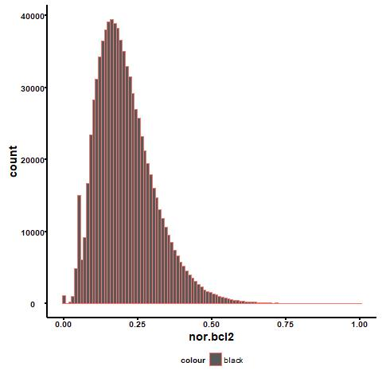
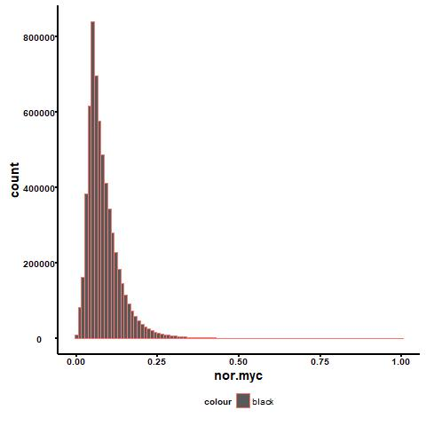
BCL2
Tumor cells (CD20+)
Min 0.00000
1Q 0.07177
Median 0.09441
3Q 0.13310
Max 1.00000
BCL2
T-cells (CD3+)
Min 0.00000
1Q 0.1373
Median 0.1926
3Q 0.2638
Max 1.00000
MYC
Tumor cells (CD20+)
Min 0.00000
1Q 0.04862
Median 0.06973
3Q 0.10430
Max 1.00000

Slide 8
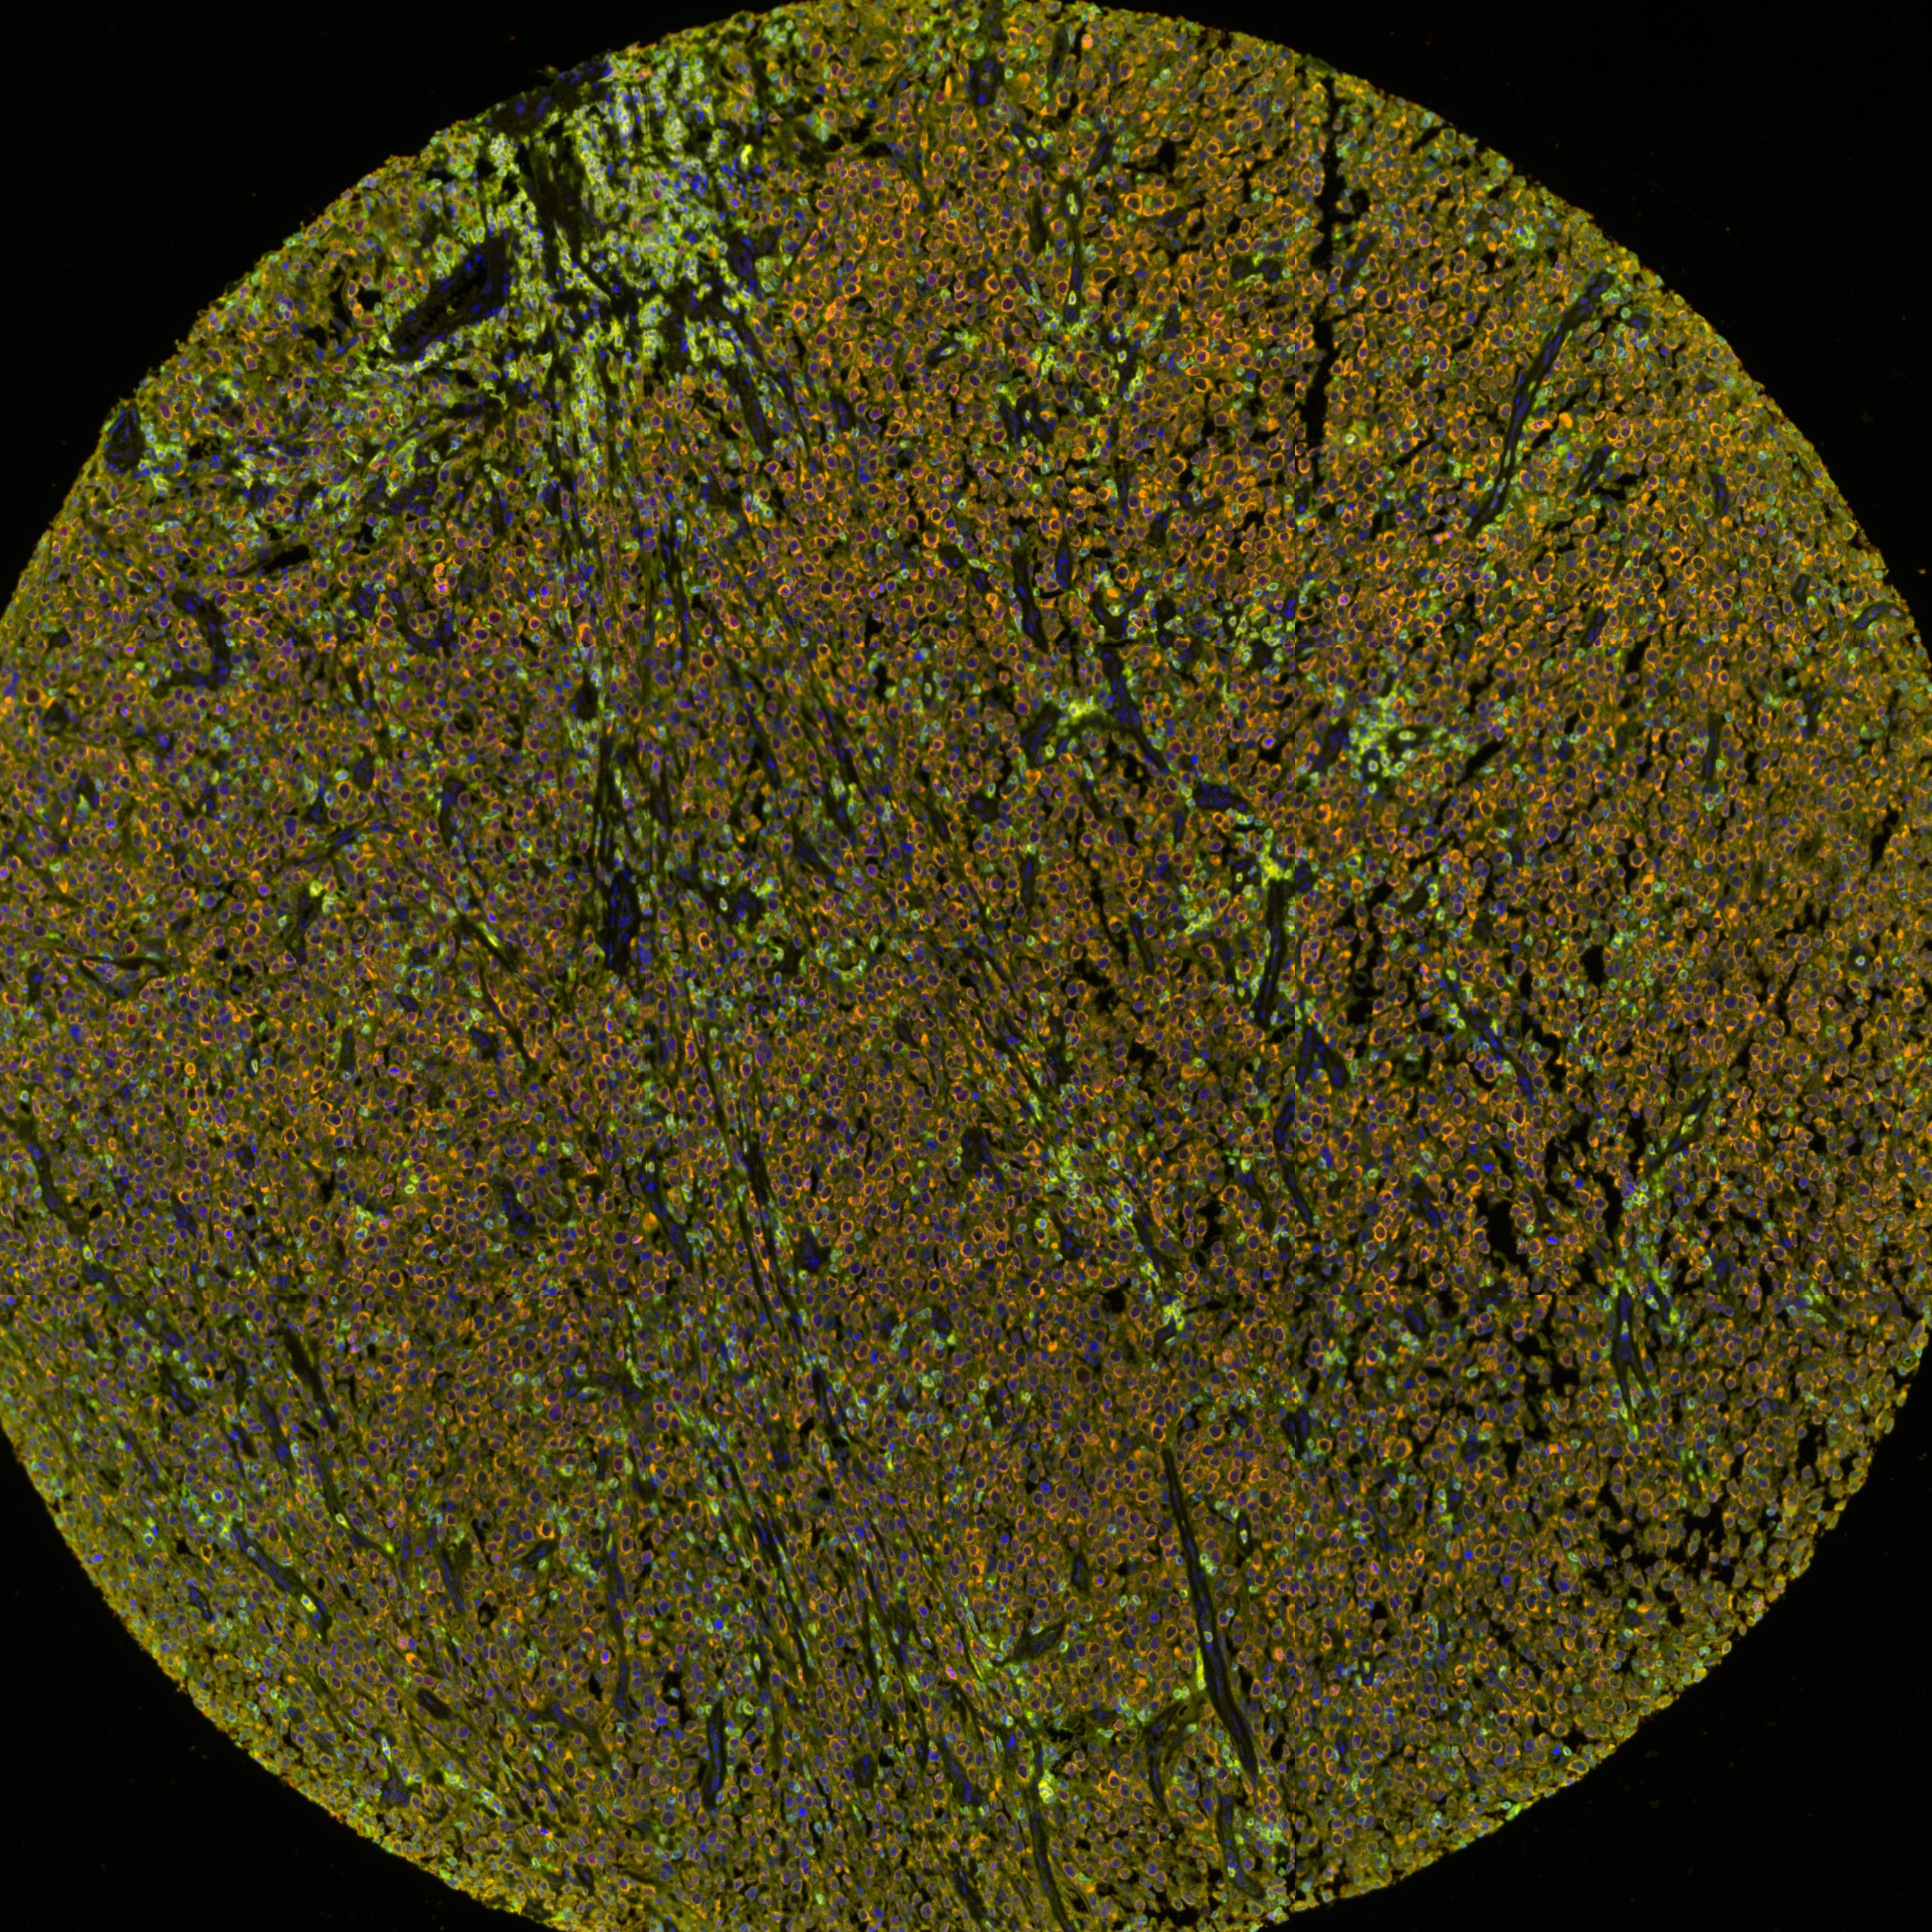
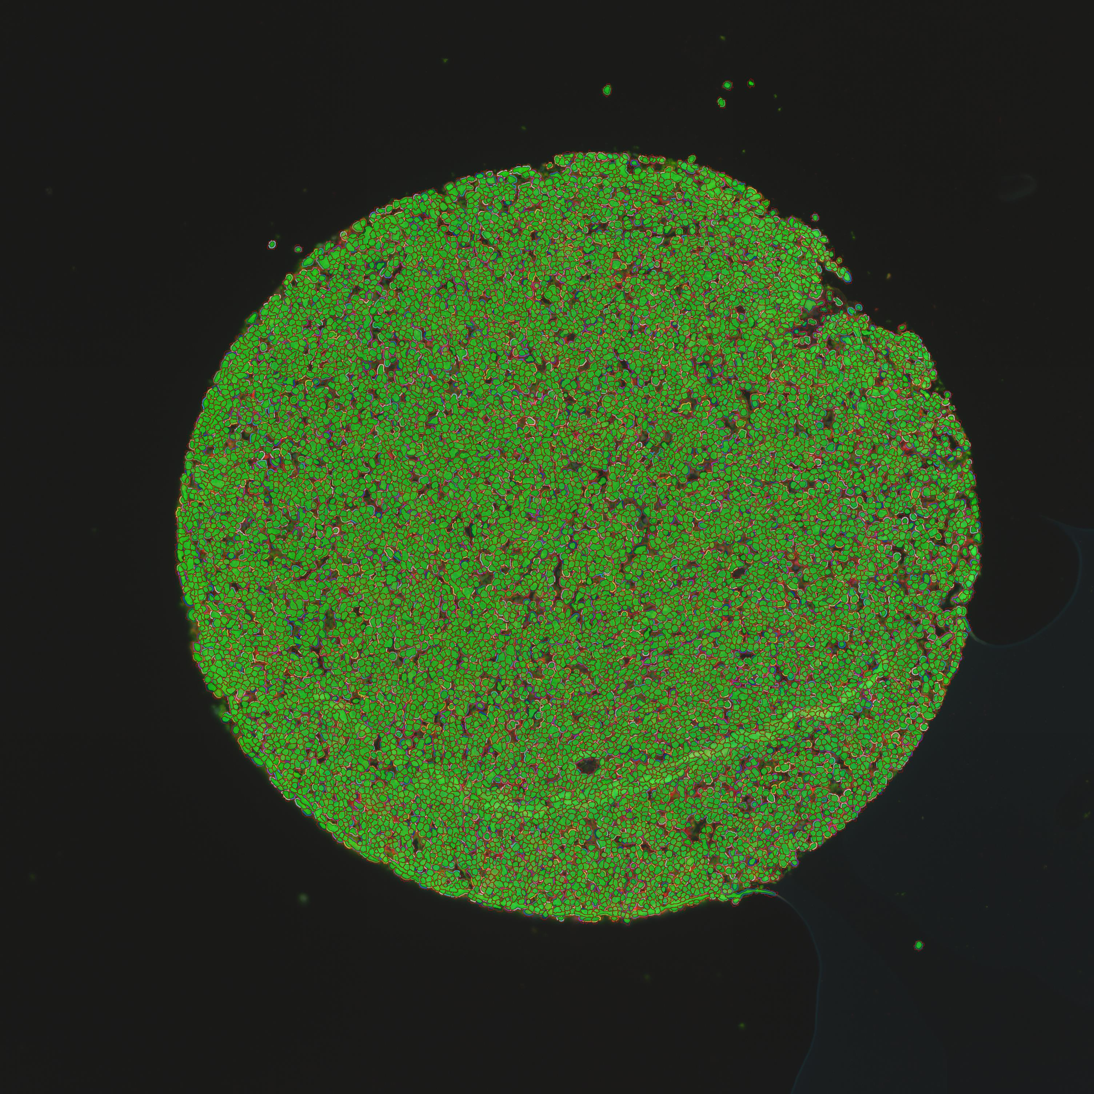
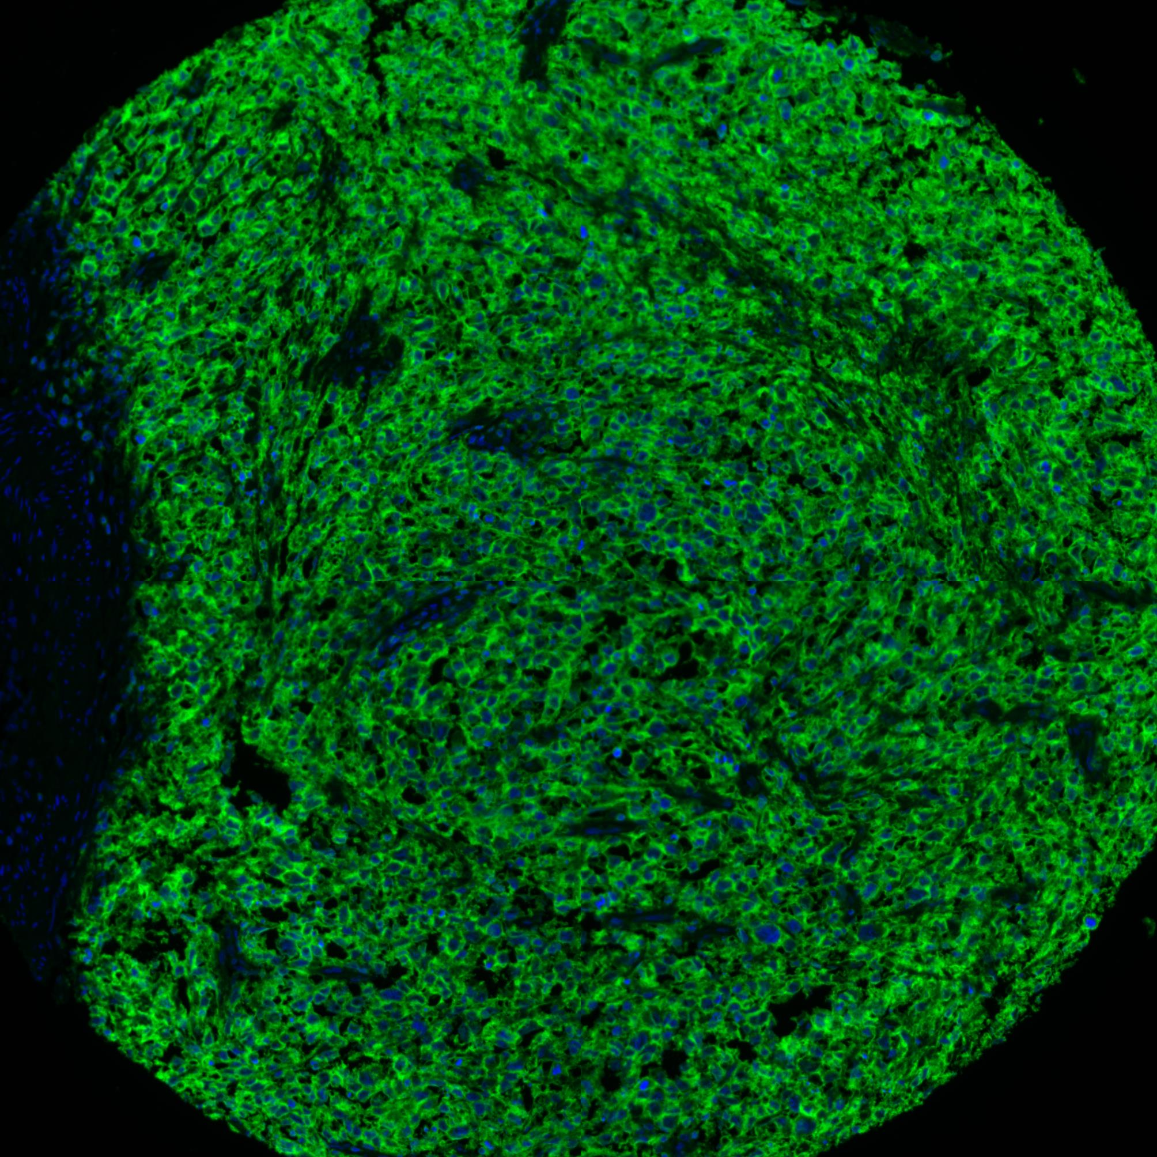
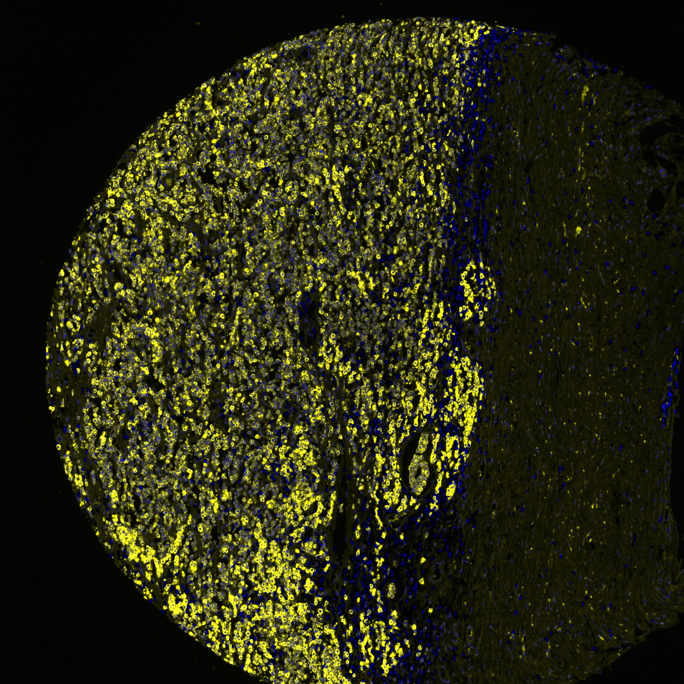
A. CD20 + BCL2 + CD3 + MYC
B. Cell segmentation
C. CD20
D. BCL2
Notes:
Supplement figure 2. Automated Quantitative analysis (AQUA) of BCL2 in diffuse large B-cell lymphoma (DLBCL). A) Composite image of CD20-Opal 650 (green), BCL2-Opal 520 (orange), CD3-Opal 570 (yellow), MYC-Opal 690, and DAPI (blue). B) Segmentation of subcellular compartments. C) CD20-Opal 650 image is used to define the tumor. CD20-Opal650 stain shows membranous pattern. D) BCL2-Opal 520 stain shows cytoplasmic pattern.

Slide 9
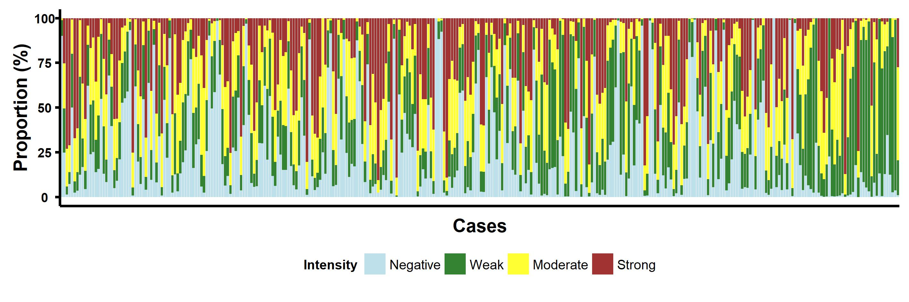
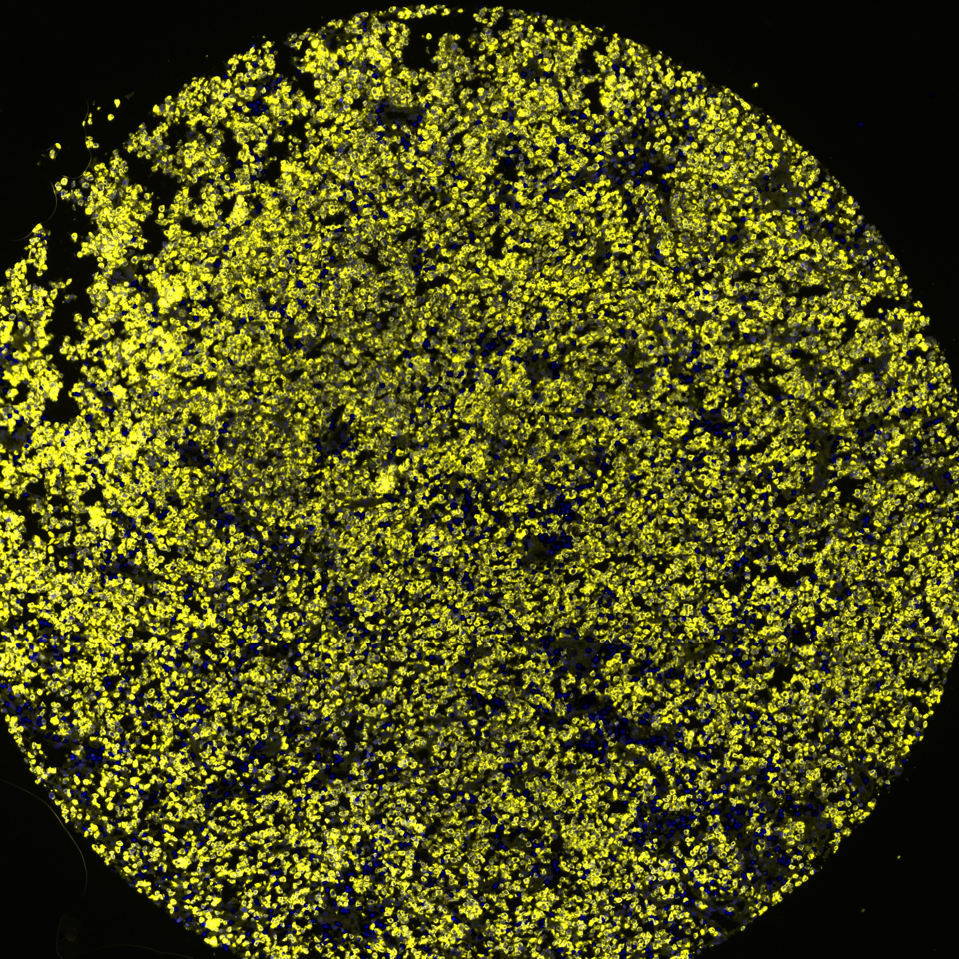
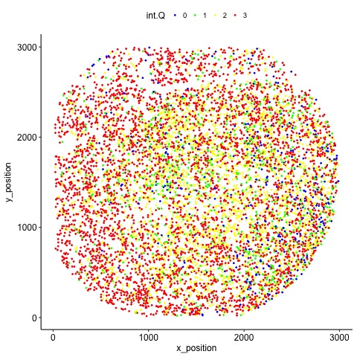
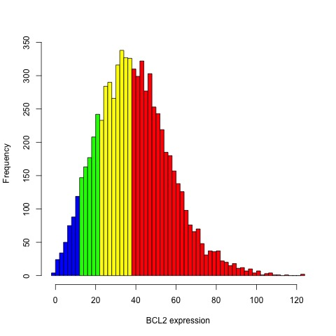
A
B
C
D
Notes:
Figure 1. A) 각 case 에서 intensity quantile 에 해당하는 세포가 다양하게 존재함을 보여줌으로써 전체적으로 BCL2 expression 이 다양하다는 것을 보여주는 그래프
MYC 이랑 같이 bar plot

Slide 10
Result
2) High BCL2 expression group categorized using conventional method (proportional cutpoint 50%) shows poor prognosis (OS, 2yr EFS). However, these subgroups also show variable BCL2 intensity.
To incorporate the staining intensity into the analysis for BCL2 expression, AQUA score was calculated. As previous analysis, conventional BCL2 subgroups show variable AQUA score.

Slide 11
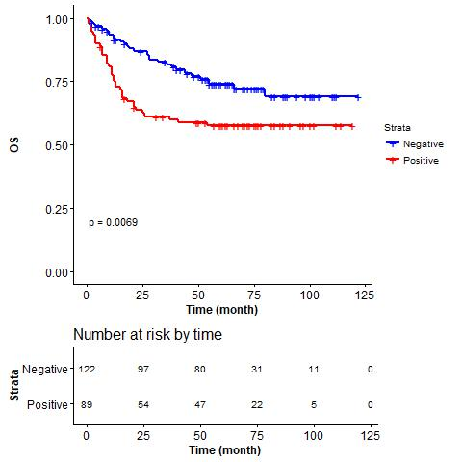
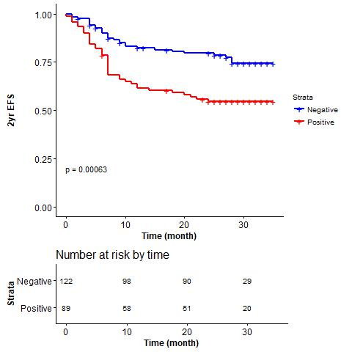

Slide 12
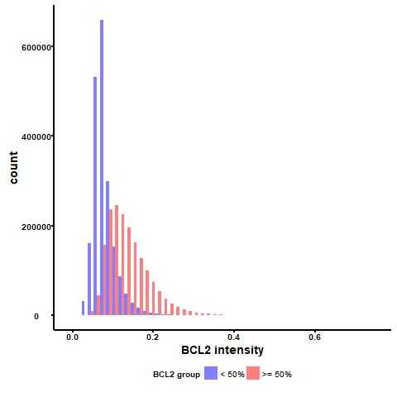
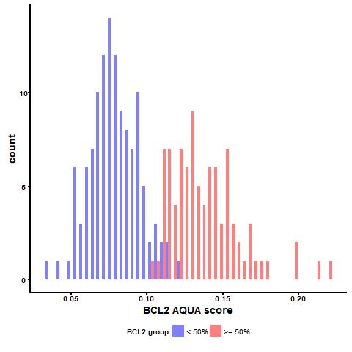

Slide 13
BCL2 negative group
AQUA score
< 10 percentile
10 ≤ AQUA < 50
50 ≤ AQUA < 90
AQUA score
> 90 percentile
BCL2 positive group
AQUA score
< 10 percentile
AQUA score
> 90 percentile
10 ≤ AQUA < 50
50 ≤ AQUA < 90
Notes:
IF image

Slide 14
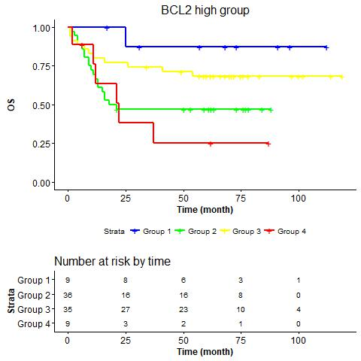
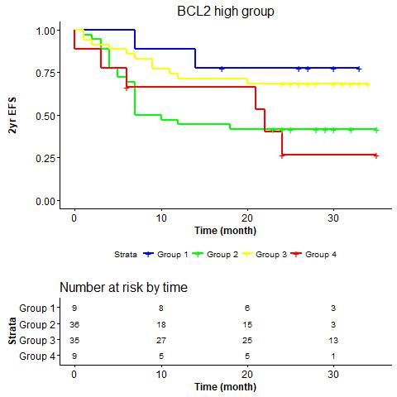
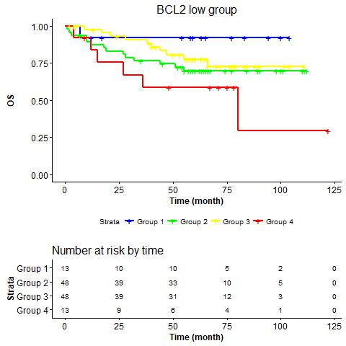
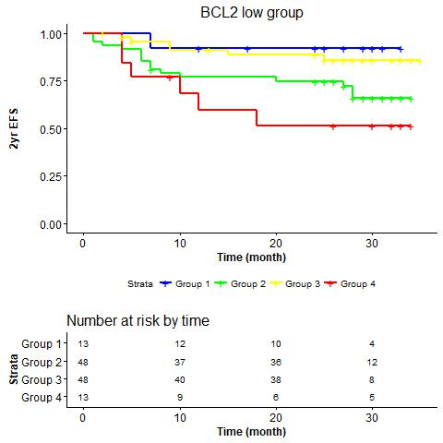

Slide 15
Result
3) Prognostic impact of BCL2 AQUA score – KM curve (OS, EFS, subgroup), MYC

Slide 16
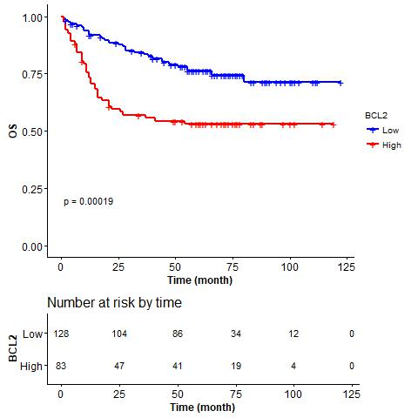
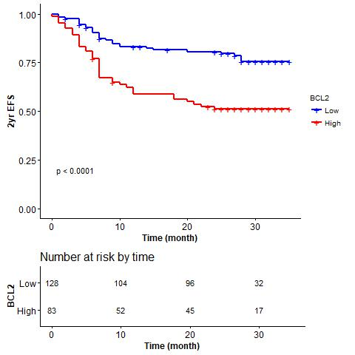
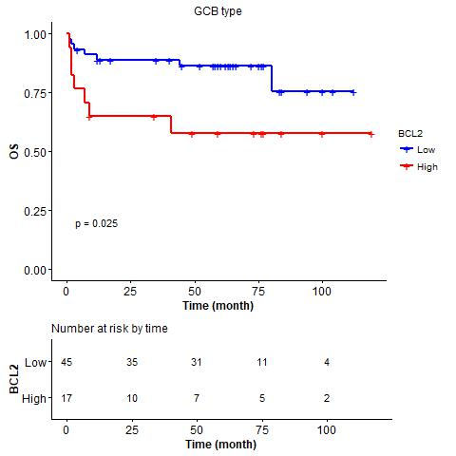
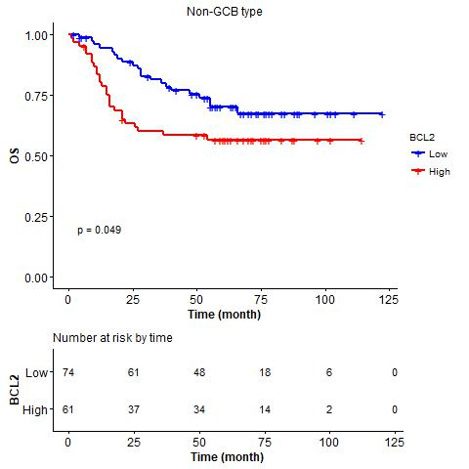
A
B
C
D
Notes:
Figure 2.
Prognostic impact of Bcl-2 expression in DLBCL. (A-B) OS (A) and 2-year EFS (B) according to the BCL2 expression in the training cohort. (E-F) OS (E) and 2-year EFS (F) according to the Bcl-2 expression in the external validation cohort.
COO 포함
MYC high/low group에서

Slide 17
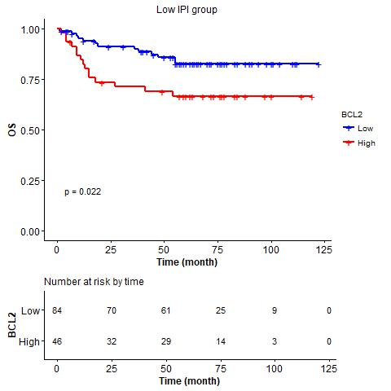
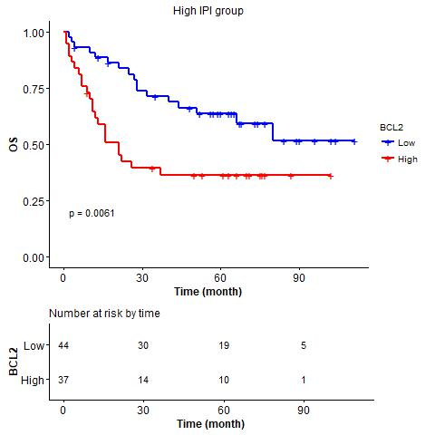
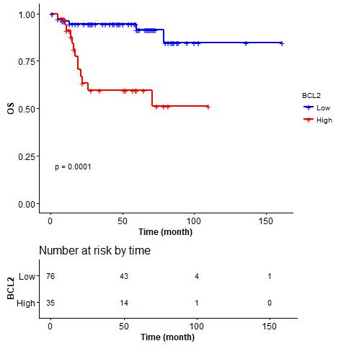
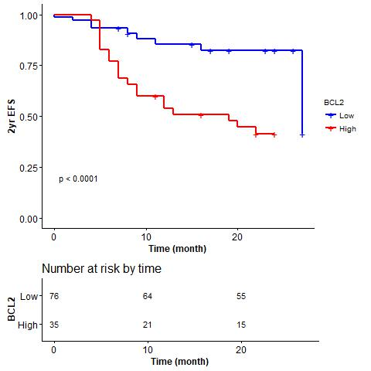
E
F
G
H
Notes:
Figure 2.
(G-H) external validation
Prognostic impact of Bcl-2 expression in DLBCL. (A-B) OS (A) and 2-year EFS (B) according to the BCL2 expression in the training cohort. (E-F) OS (E) and 2-year EFS (F) according to the Bcl-2 expression in the external validation cohort.

Slide 18
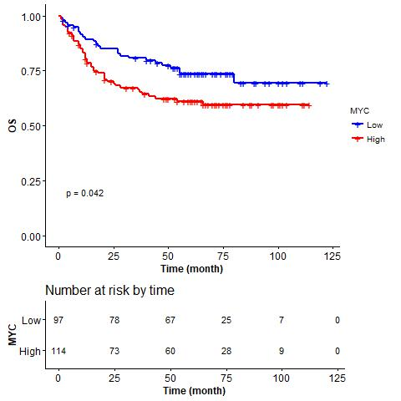
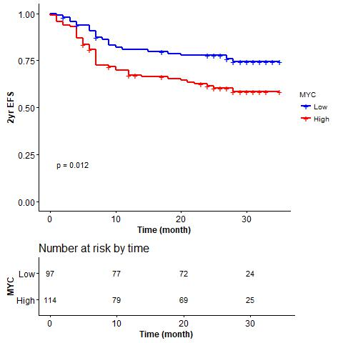
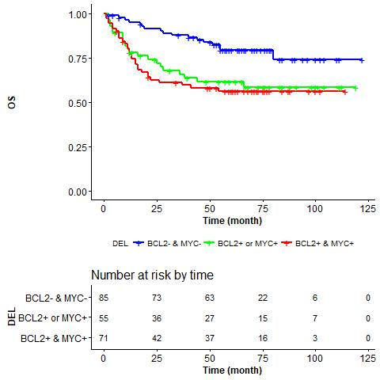
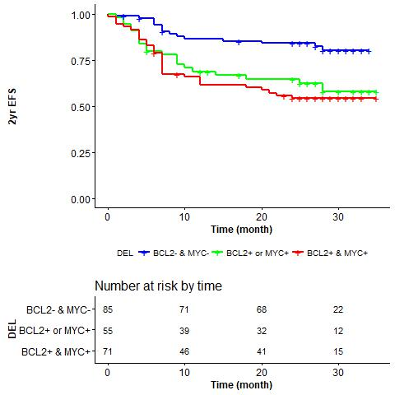
A
B
C
D
Notes:
Figure 4. MYC (OS), MYC (EFS), DEL (OS), DEL (EFS)
Prognostic impact of Bcl-2 expression in DLBCL risk-stratified according to COO and IPI. (A-B) OS according to the Bcl-2 expression in the GCB subtype (A) and the non-GCB subtype (B) of DLBCL. (C-D) OS according to the Bcl-2 expression in the high IPI risk group (C) and the low IPI risk group. (E-F) OS (E) and 2-yr EFS (F) of patients stratified according to the Bcl-2 expression and IPI risk scores (Group 1: Bcl-2 lo & IPI lo, Group 2: Bcl-2 hi & IPI lo, Group 3: Bcl-2 lo & IPI hi, Group 4: Bcl-2 hi & IPI hi).

Slide 19
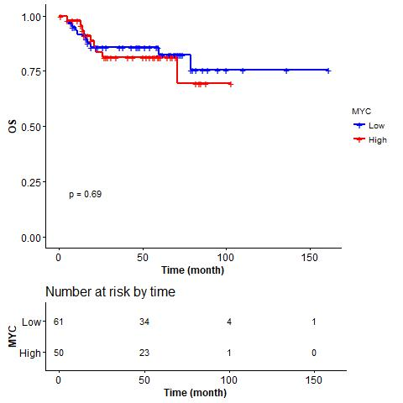
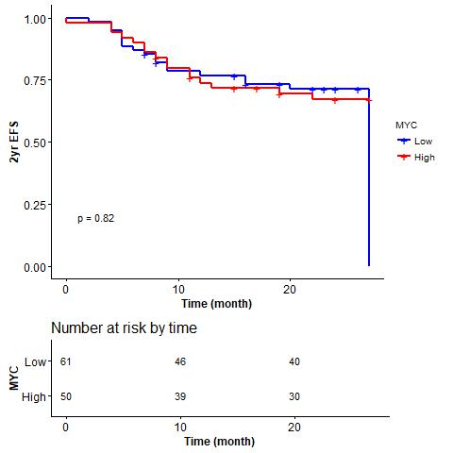
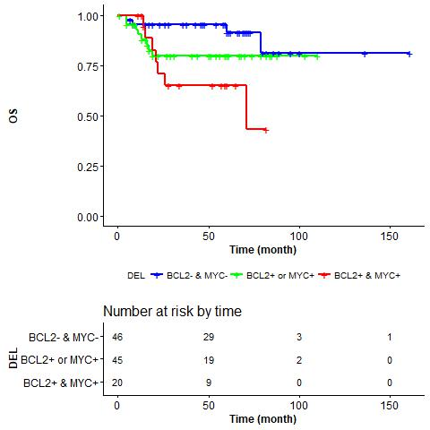
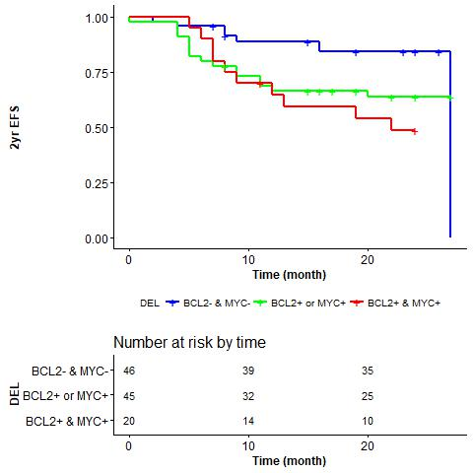
E
F
G
H
Notes:
Figure 3. MYC (OS), MYC (EFS), DEL (OS), DEL (EFS) – external validation

Slide 20
Result
4) Prognostic impact of BCL2 AQUA score is independent of other clinicopathologic factors
- cox, MFP

Slide 21
 | Univariate analysis |  |  | Multivariate analysis
Variables | HR | 95% CI | p-value | HR | 95% CI | p-value
Age > 60y | 3.269 | 1.923-5.557 | < 0.0001 | 3.039 | 1.704-5.418 | 0.0002
Extranodal involvement ≥ 2 | 1.824 | 1.098-3.030 | 0.0203 | 1.148 | 0.613-2.152 | 0.6666
Elevated LDH level | 2.035 | 1.216-3.404 | 0.0068 | 1.507 | 0.826-2.751 | 0.1816
Stage III-IV | 1.474 | 0.857-2.534 | 0.1610
BM involvement | 1.802 | 1.047-3.100 | 0.0334 | 0.940 | 0.485-1.823 | 0.8542
Performance state 2-4 | 3.643 | 1.997-6.647 | < 0.0001 | 2.166 | 1.102-4.258 | 0.0251
Bcl-2 high | 2.131 | 1.287-3.529 | 0.0033 | 2.434 | 1.246-4.754 | 0.0092
MYC high | 1.758 | 1.042-2.967 | 0.0345 | 0.760 | 0.372-1.553 | 0.4517
COO | 1.504 | 0.728-2.732 | 0.1800
Notes:
Table 2. Univariate and multivariate analysis with OS
IPI를 풀어서 multivariate에 넣음 → ok?
Bcl-2의 중요도가 강조되기는 하는데… Ann Arbor stage 가 multivariate에서 빠져도 되는건가..?

Slide 22
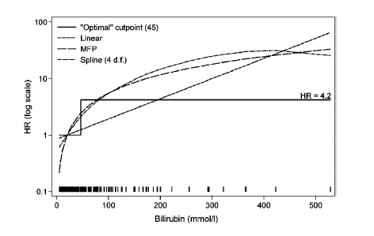
Notes:
Table 3. The MFP algorithm applied to the DLBCL data set

Slide 23
Result
5) Prognostic model using BCL2 – MFP PI group

Slide 24
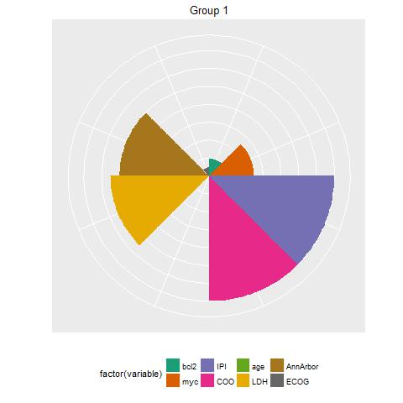
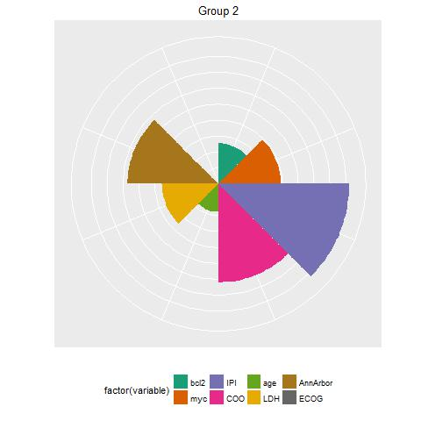
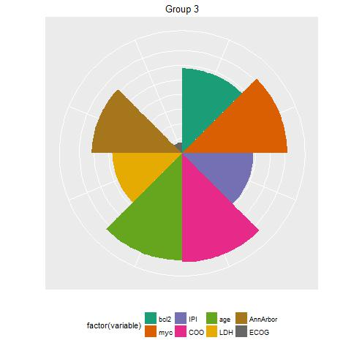
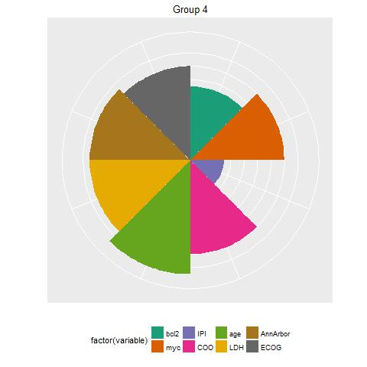
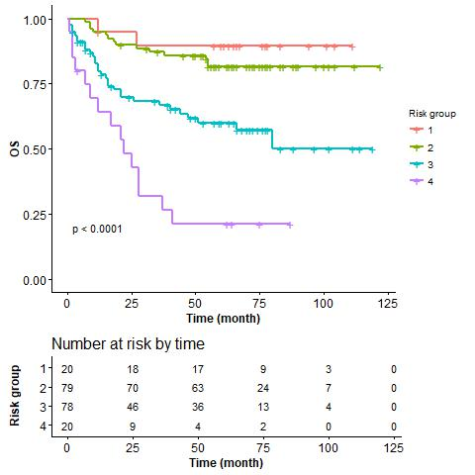
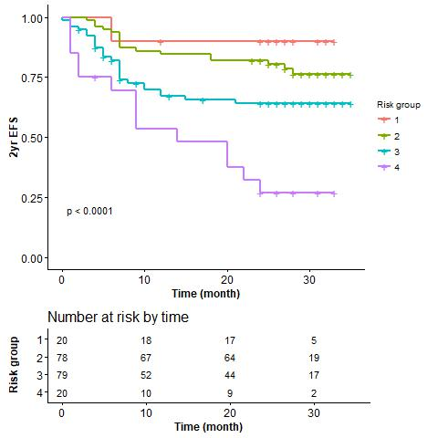
Notes:
Figure 5. Kaplan-Meier curves for 4 risk groups based on prognostic score from the multivariable fractional polynomial model. Each groups are categorized by applying cutpoints to the prognostic score at the 10th, 50th, and 90th centiles.

Slide 25
Discussion point
1) multiplex IF : segment tumor cells
AQUA score : quantitative analysis + intensity
2) pitfall of dichotomizing group analysis
: subgroup 간의 데이터는 스터디마다 상이함, 서로 다른 cutoff
MFP algorithm
→ supplement figure
3) BCL2 expression → possible treatment strategy with venetoclax
4) possible staging system → MFP risk group, IPI + BCL2

Slide 26
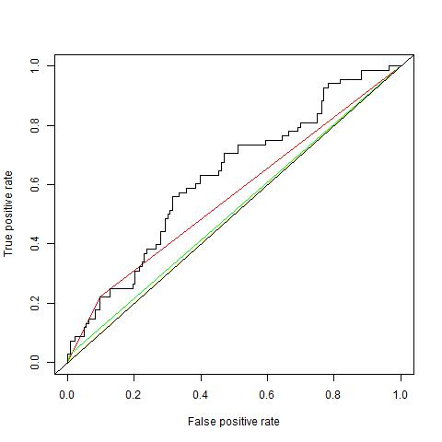
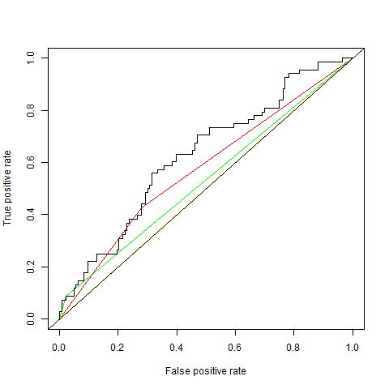
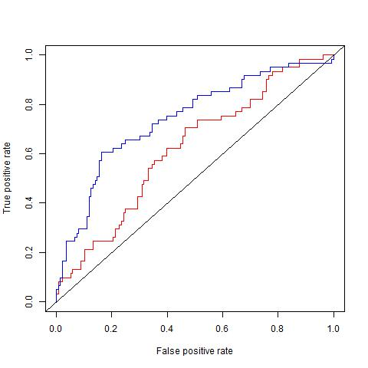
Notes:
supplement figure for discussion point 1)
A) 50% cut off vs AQUA
B) 30% cut off vs AQUA
(C) AQUA alone vs MFP PI) 요 figure 는 어디로..?

Slide 27
Additional images

Slide 28
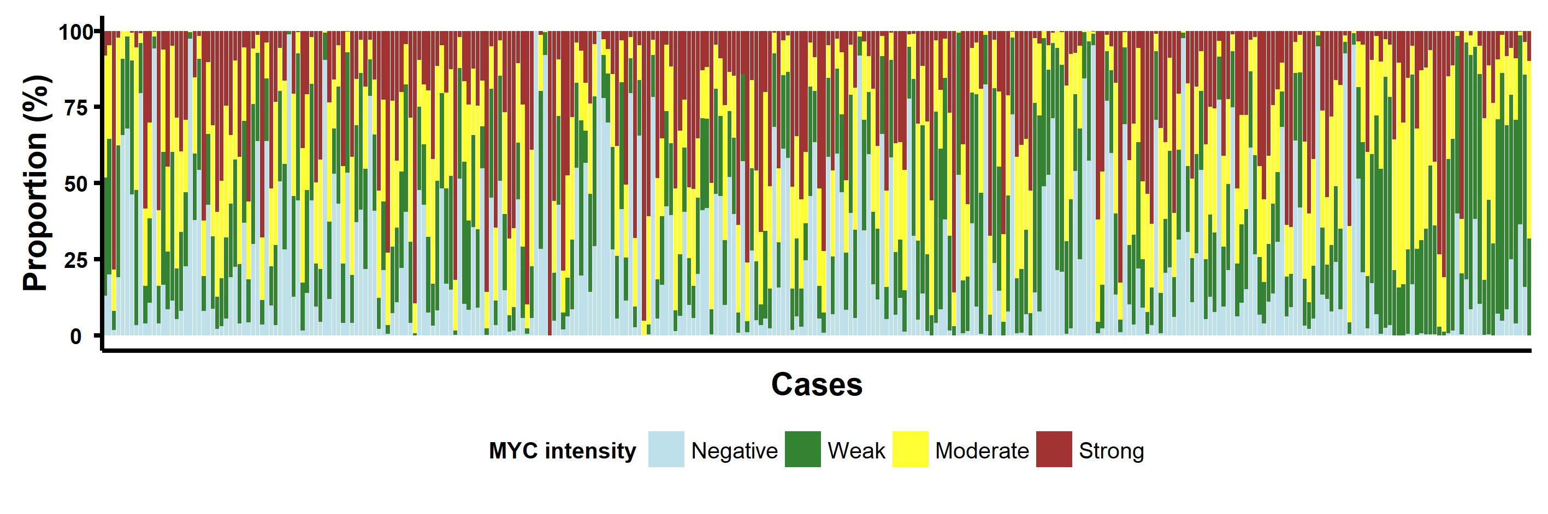

Slide 29
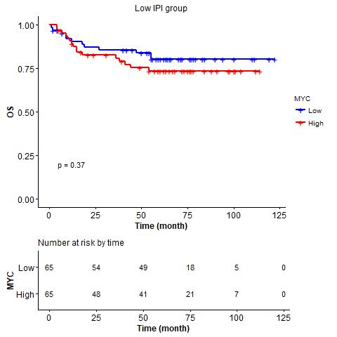
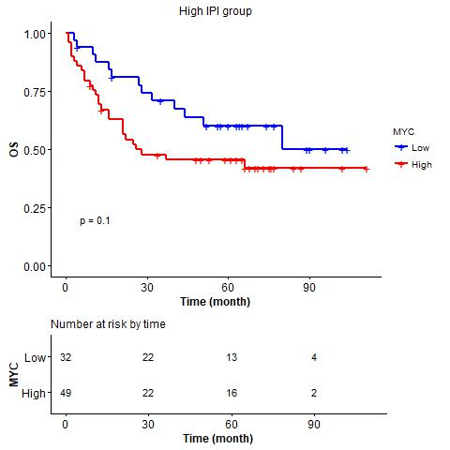

Slide 30
